Slide 1
BSW Public Health
Introduction
Part 2

Slide 2

The Local Authority Public Health Workforce
Director of Public Health
Public Health Consultants
Public Health Specialists
Knowledge Managers
Information Specialists
Public Health Analysts
Public Health Practitioners
Notes:
There are many individuals that make up the public health workforce and this will differ between different local authorities. The director of Public Health sits at the top and is responsible for the strategic direction of public health within their local authority area. This is a statutory position that sits within the local authority and is accountable to the secretary of state for health and social care.
Public Health Consultants and Specialists are responsible for the delivery of programmes as well as their strategic direction. Knowledge Managers are responsible for individual programmes within public health, they bring together an understanding of the data and evidence. Information Specialists and Public Health Analysts are responsible for gathering, analysing, interpreting and presenting data.
Each member of the public health workforce will have an area of special interest and will belong to a team within the public health workforce. These teams can vary between local authorities but examples may include health improvement teams who will provide interventions to improve population health and vulnerable community teams who will oversee services for drugs and alcohol, safeguarding, antisocial behaviour and domestic abuse.
It is also important to appreciate the importance of job roles that are not directly public health roles but have a huge influence on public health. This might include town planners, health visitors, school nurses, transport planners and environmental health officers to name a few. All of these individuals have a role in improving health.

Slide 3


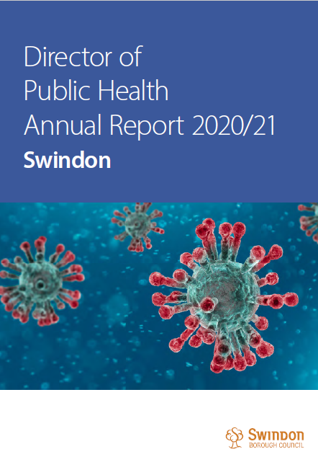
What does Public Health mean in BSW?
Notes:
Each year the Director of Public Health in a local authority releases an annual report outlining the work that has been completed over the preceding year as well as the upcoming priorities for the following year. This is a statutory responsibility that has been a requirement for almost 150 years. Follow the links to read the annual reports for Bath and North East Somerset, Swindon and Wiltshire to learn more about what each area has been focussing on.
The Director of Public Health Report | Bathnes
Public health annual report | Swindon Borough Council
Public health intelligence - Wiltshire Council
?more on this, could develop infographic highlighting key findings from each report

Slide 4
Applying a Public Health Approach
Upstream Approaches
Making Every Contact Count
Consider the root cause of a problem and interventions to stop the problem recurring.
Identify opportunities to start conversations about healthier behaviours.
Population Strategies
Consider interventions that benefit a population as a whole, rather than just reaching specific high risk individuals.
Notes:
Public Health can seem overwhelming and as it works at a population level it can be difficult to think about how to apply Public Health principles to your day-to-day job role. There are a few simple concepts that can be applied to many places of work. One consideration is to consider using population strategies rather than high risk strategies when making interventions. Population-based strategies work to maximise the number of individuals an intervention can reach, rather than focusing solely on individuals that may be at highest risk. Another consideration is to work upstream. This is the idea of encouraging professionals to think what happened to cause a problem and whether they could have a role in stopping the same problem happening again. A third concept is that of making every contact count. MECC is an approach to behaviour change that uses the millions of day-to-day interactions that organisations and people have with other people to support them in making positive changes to their health. It uses brief and very brief (30 second) interventions, delivered whenever the opportunity arises to promote positive behaviour change and support individuals to make these changes for the benefit of their health and well-being, whether this is to stop smoking, increase physical activity levels or seek help for their mental health.

Slide 5
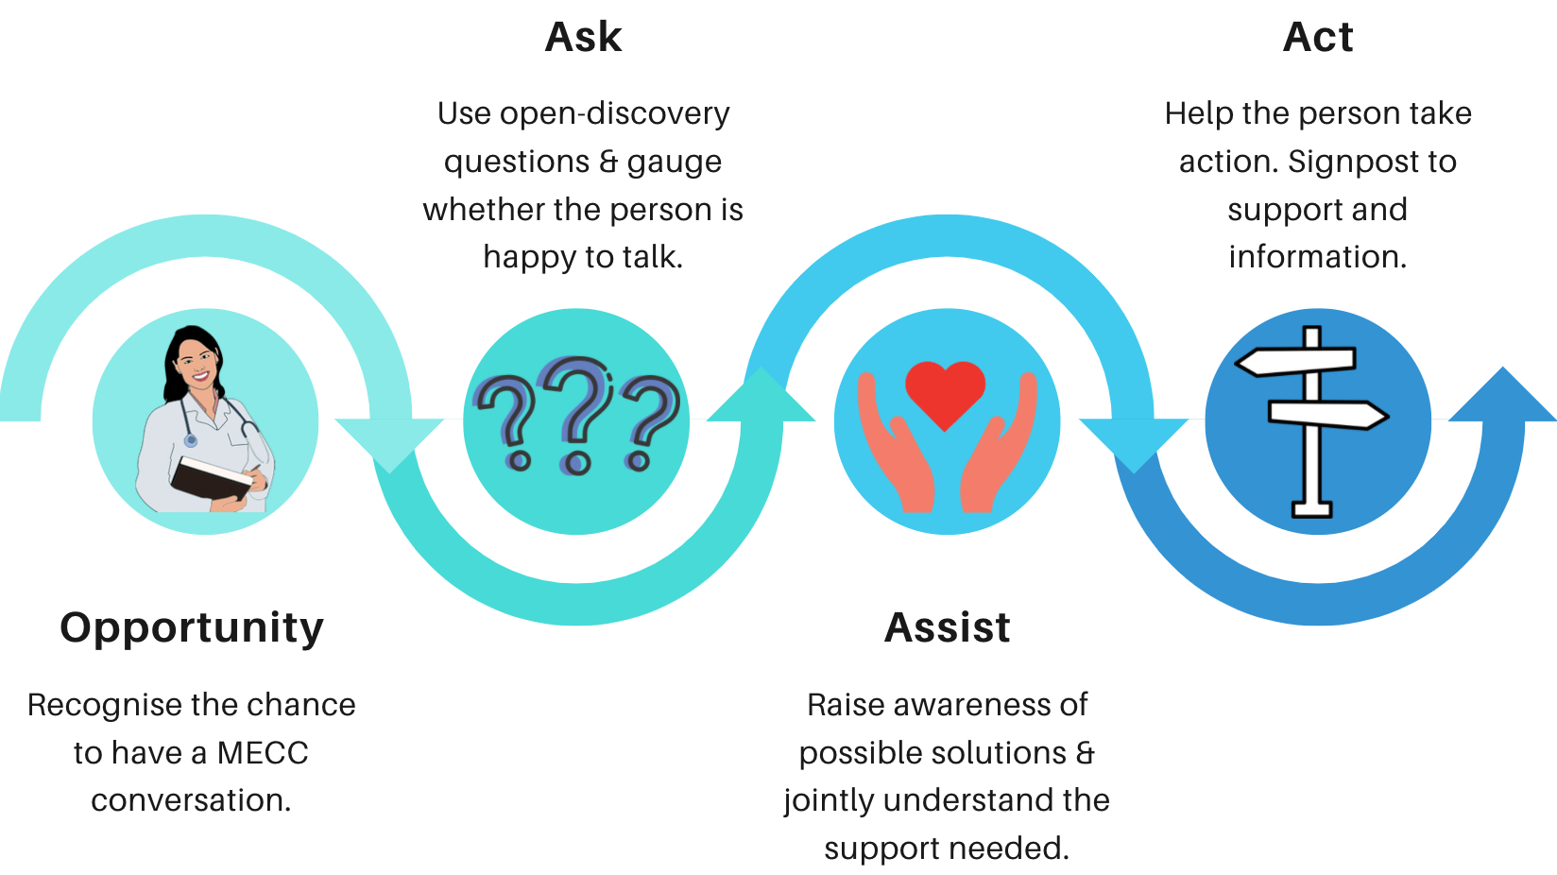
MECC: Making Every Contact Count
Notes:
There is formal training available to become skilled in MECC, but lets discuss the concept a little further in this module. This is one model can be used: Ask, Assist and Act. The idea is to recognise that an individual might be open to discussing their health, lifestyle or well-being. MECC is not about giving advice or dictating what an individual should or shouldn’t do, but instead focuses on working with the individual to understand the changes they think they could achieve and directing them to further resources or information to assist this change.
Video link: A Firefighters Perspective - Making Every Contact Count (MECC) - YouTube

Slide 6
Knowledge Check
Which of the following groups may experience health inequalities?
  A) Individuals experiencing homelessness
  B) BAME communities
  C) Individuals of low socio-economic status
Notes:
The correct answer is all of them. All of these groups may experience health disadvantages.

Slide 7
Knowledge Check
What are the key functions of Public Health?
  A) Preventing disease, treating disease, promoting healthy lifestyles
  B) Health protection, health improvement, health intelligence, healthcare public health
  C) Health monitoring, health protection, health surveillance, health response
Notes:
The correct answer is B. Health protection involves protecting the population from ill-heath. Health improvement aims to promote healthy lifestyles and implement changes within society that aim to make it easier for individuals to lead a healthier lifestyle. Health intelligence involves measuring, monitoring and reporting population health and wellbeing. Healthcare public health works to improve population health by preventing disease and improving health-related outcomes by managing access and utilisation of healthcare interventions.

Slide 8
Knowledge Check
What are the four stages of developing Public Health Intelligence?
  A) Data, information, intelligence, insight
  B) Information, data, insight, intelligence
  C) Insight, data, information, intelligence
Notes:
The correct answer is A. Firstly raw data is collected then context is provided so that this becomes information. Intelligence involves adding meaning to the information. Finally, developing an understanding of what the information means and what needs to be done about it is known as insight

Slide 9
Knowledge Check
Which organisation provides intellectual, scientific and operational leadership at both a national and local level to ensure the nation’s health is secure?
  A) Local authority
  B) The UK Health Security Agency
  C) The Office for Health Improvement and Disparities
Notes:
The correct answer is B.

Slide 10
Knowledge Check
What are the main goals as set out by the Public Health Outcomes Framework?
  A) Reduce incidence of non-communicable disease and increase the healthy lifespan across all communities
  B) Increase lifespan of the population and reduce health inequalities between different communities
  C) Increase healthy life expectancy and reduce the differences in life expectancy and healthy life expectancy between communities
Notes:
The correct answer is C. The public health outcomes framework sets out a vision for public health which is to improve and protect the nation’s health and improve the health of the poorest first. There are two high level outcomes that need to be achieved to reach these goals: increase healthy life expectancy and reduce the differences in life expectancy and healthy life expectancy between communities.

Slide 11
Resources: Downloadable
Infographic summarising this slide set
Notes:
An A4 downloadable infographic to summarise the content within the presentation.

Slide 12
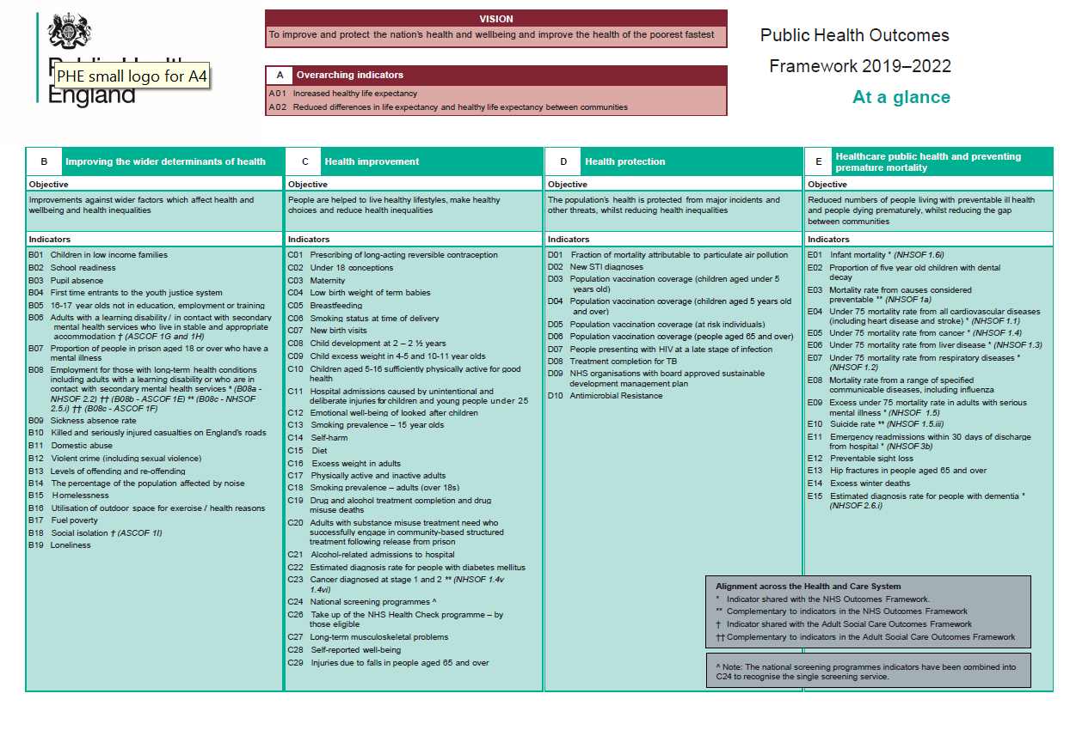
Resources: Downloadable
Public Health Outcomes Framework: At a Glance
Notes:
Public Health Outcomes Framework: indicator changes 2019 to 2022 - GOV.UK (www.gov.uk)

Slide 13
Resources: Downloadable
Director of Public Health Annual Reports for BSW
Notes:
The Director of Public Health Report | Bathnes
Public health annual report | Swindon Borough Council
Public health intelligence - Wiltshire Council

Slide 14
Case Studies:
Warm & Safe and Vaccinations
Addressing the National Syndemic: Place-based problems and solutions to UK health inequality - IHE (instituteofhealthequity.org
Notes:
Could include video recordings from the case studies of this document:
Addressing the National Syndemic: Place-based problems and solutions to UK health inequality - IHE (instituteofhealthequity.org)
Page 28 – Warm & Safe Case Study
Page 31- Addressing Vaccine Hesitancy

