Slide 1


Public Health
Module 2: Making Every Contact Count
Notes:
Welcome to this BSW Academy Public Health Module on Making Every Contact Count. In this module we’ll be discussing the concept of MECC including what MECC is and why it’s important, some of the communication techniques involved and how to signpost individuals for further support.

Slide 2
Objectives
Understand what MECC is and the philosophy behind MECC
Learn the communication skills involved in having a MECC conversation
Understand how to signpost individuals for further support
Be familiar with the concept of setting SMARTER goals
Notes:
The objectives for this module are as follows:

Slide 3
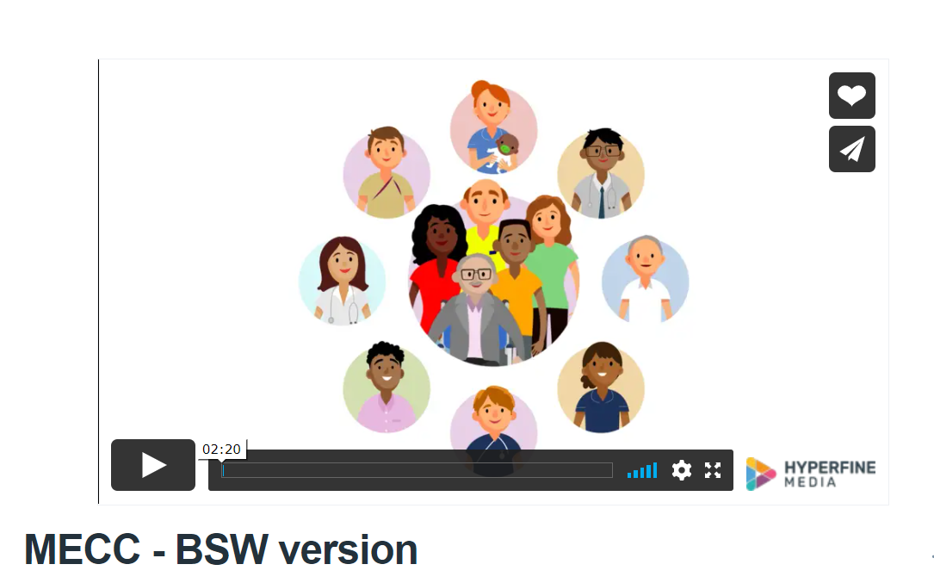
Introduction
Notes:
MECC is an opportunity to talk about health and wellbeing​ that involves conversations centred around an individual rather than giving or offering solutions​. Before we learn more about what MECC is and how to have these conversations, follow the link to watch this MECC video created by BSW so that you can get an introduction to the topic.
MECC - BSW version (vimeo.com)
MECC is an opportunity to talk about health and wellbeing​ that involves conversations centred around an individual rather than giving or offering solutions​. Before we learn more about what MECC is and how to have these conversations, follow the link to watch this MECC video created by BSW so that you can get an introduction to the topic.
MECC - BSW version (vimeo.com)

Slide 4
What is MECC?
MECC is an approach to behaviour change that uses the millions of day-to-day interactions that organisations and people have with other people to support them in making positive changes to their health¹
MECC uses brief and very brief (30 seconds) interventions, delivered whenever the opportunity arises in routine appointments and contacts
As clinicians, MECC means having the competence and confidence to deliver healthy lifestyle messages, to help encourage people to change their behaviour and to direct them to local services that can support them¹
Notes:
Hopefully the introductory video provided a useful overview of what MECC is. MECC is an evidence-based approach to improving people's health and wellbeing by helping them change their behaviour. It enables the delivery of consistent and concise health and wellbeing information and encourages individuals to engage in conversations about their health at scale across organisations and populations. The idea is that these messages can be delivered in very brief interactions so its something we can aim to include in our short consultations. The idea is to encourage conversations about stopping smoking, improving diet, increasing physical activity, losing weight and reducing alcohol consumption and then direct the individual to further support. MECC is about having that initial conversation.

Slide 5
Why is MECC important?
‘Many long-term diseases affecting our population are closely linked to known behavioural risk factors, with 40% of the UK’s disability adjusted life years lost being attributable to tobacco, hypertension, alcohol, being overweight or being physically inactive’²
‘Interventions to change behaviour have enormous potential to alter current patterns of disease. A genetic predisposition to disease is difficult to alter. Social circumstances can also be difficult to change, at least in the short to medium term. By comparison, people's behaviour – as individuals and collectively – may be easier to change’³
>1 million people in contact with NHS every 24hours
Notes:
MECC is part of NHS Long Term Plan and evidence suggests adoption of the MECC approach across health and care could have a significant impact on the health of our population. We know that many of the long-term diseases that affect our population are closely linked to behavioural risk factors, so if we can encourage behaviour changes this can have a significant impact. MECC isn’t just for health and social care staff though, MECC is something that is relevant to anyone that interacts with the public so this training is useful for a wide range of individuals, hairdressers are a great example as they have a public-facing role and have conversations with customers every day. The reason MECC is so relevant to health and social care staff however, is that the NHS has more than a million contacts every day. That effectively represents a million opportunities where we could be encouraging these types of healthy behaviour change conversations.

Slide 6
MECC Philosophy
You are not responsible for the choices people make
Being given information alone does not make people change
People do come to us with solutions
It is not possible to persuade people to change their habits
Notes:
MECC conversations are based on a few principles. Firstly, we are not responsible for the choices people make. MECC is focused on having supportive conversations about positive behaviour change, not ensuring they make the decisions we want them to make to improve their health. Secondly, being given information alone does not make people change. Most people know, for example, that smoking is bad for health and increases the risk of many cancers – but this information alone is not enough to break the habit of smoking. Individuals need empowerment and support to make a change. The next principle is that people come to us with solutions. We don’t need to tell people what to do, we need to encourage them to provide the solution as they will be much more likely to stick to a behaviour change if the idea is their own. And finally, it is not possible to persuade people to change their habits. MECC is not about persuasion or convincing somebody to change, it is about having open, supportive conversations and signpost individuals that want to make a change.

Slide 7
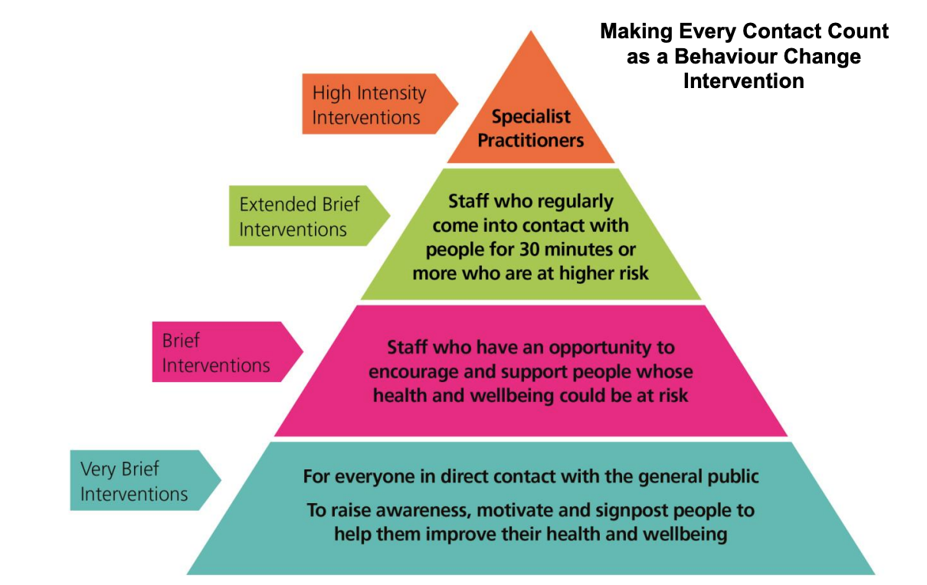
MECC Interventions
Notes:
This pyramid represents the different types of behaviour change interventions that exist. MECC sits at the bottom in the blue and pink sections. MECC is focussing on brief, or very brief interventions. The expectation is to encourage and support individuals to make positive changes, rather than to be specialists providing high intensity interventions. The aim is to raise awareness, motivate and signpost individuals so that they are empowered to make behavioural changes. The benefit to this is that applying MECC in our everyday work shouldn’t take up much time, these conversations can take 30 seconds to a few minutes. These interventions are also designed so that you don’t need to be an expert – remember these conversations are designed to get information from the individual you are talking about – what do they want to change? What do they want to do to improve their health? This means you don’t need to have health facts and advice ready to share, you just need to identify the opportunity to have a conversation, ask some open questions and listen!

Slide 8
Having a MECC Conversation
Recognise the opportunity to have a MECC conversation
Use open-discovery questions to understand a persons needs
Provide information rather than give advice
Notes:
So how do you have a MECC conversation? When thinking about making every contact count there are a few key principles to focus on – firstly, recognizing the opportunity to engage a patient, then using open discovery questions (which we’ll cover later) to learn more about the patient and the type of support they might need to make a change, and finally providing further information for the patient. Remember, the emphasis on MECC is to support and guide, rather than to tell a patient what to do.

Slide 9
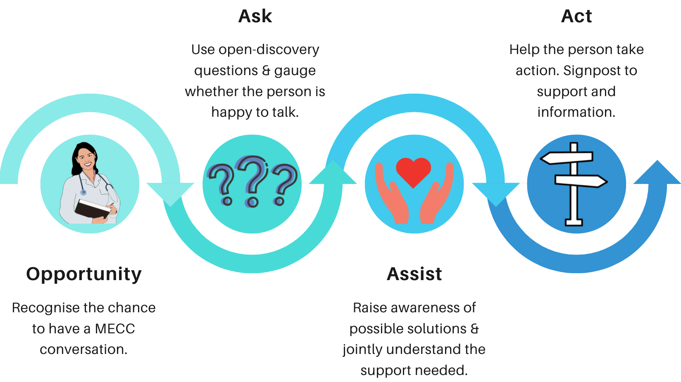
Ask, Assist, Act
Notes:
This is one model that can be used when having a MECC conversation:
Ask a question to gauge whether the person is happy to talk about it and discuss further
Assist in raising their awareness to possible solutions and jointly understanding the support the person needs.
Help them take ACTion. You can ask them what their next steps will be. Be supportive and encouraging of change an you could signpost many forms of information and support.

Slide 10
Open-Discovery Questions
Open discovery questions allow the conversation to be led by the person and move the conversation away from staff giving solutions or offering suggestions.
‘What’ and ‘How’ questions
Notes:
When having these conversations the idea is for the conversation to be led by the individual rather than a paternalistic approach. A useful way to do this is to focus on what and how questions. So rather than asking, ‘why don’t you do more walking’ it can be re-phrased as ‘what do you think you could do to increase how much walking you do’. This really encourages individuals to think about what they need to do, or what help they need, which can aid in motivation. This links back to the idea that individuals come to us with their own solutions! There is no point in us offering help or solutions that a patient doesn’t agree with as they are much less likely to engage.

Slide 11
Open-Discovery Questions
What do you think you could do to improve your well-being?
What if you tried this?
How do you think you could achieve this?
What is important for your well-being in your view?
Notes:
Here are some examples of what and how questions that can be used in MECC conversations. Next time you’re having a conversation why not try and rephrase how you ask something and see what response you get.

Slide 12
Popping in a positive
Acknowledge the small things the person may have achieved
Acknowledge that they are continuing to explore the change even if it didn’t work last time round.
Notes:
People can often be quite tough on themselves and focus on all the times they’ve failed or that they can’t do something. So it can be really useful to acknowledge what a person has been able to achieve or even just the fact that they are having the conversation and that they want to make a change.

Slide 13

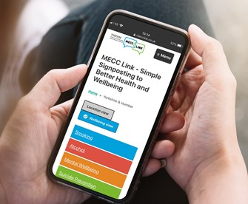
Signposting
Notes:
MECC Link - Simple signposting to better health and wellbeing
Signposting individuals so that they can get further support can feel daunting. If you’re unfamiliar with a local area or you don’t work in health or social care you might not know what resources are available to help individuals get support to stop smoking or become more active for example. This is where MECC link can be used. MECC Link is a website that provides links to a wide variety of resources in specific areas. There is a different page for each area of the country – so for BSW there is a Banes, Swindon and Wiltshire page. There are then resources for all forms of support – from problem gambling and homeless, to falls and frailty. Click on the link to explore what your local area has to offer. This link can be shared with individuals so once you’ve made your brief MECC intervention, they can go home and access ongoing support via MECC link.

Slide 14
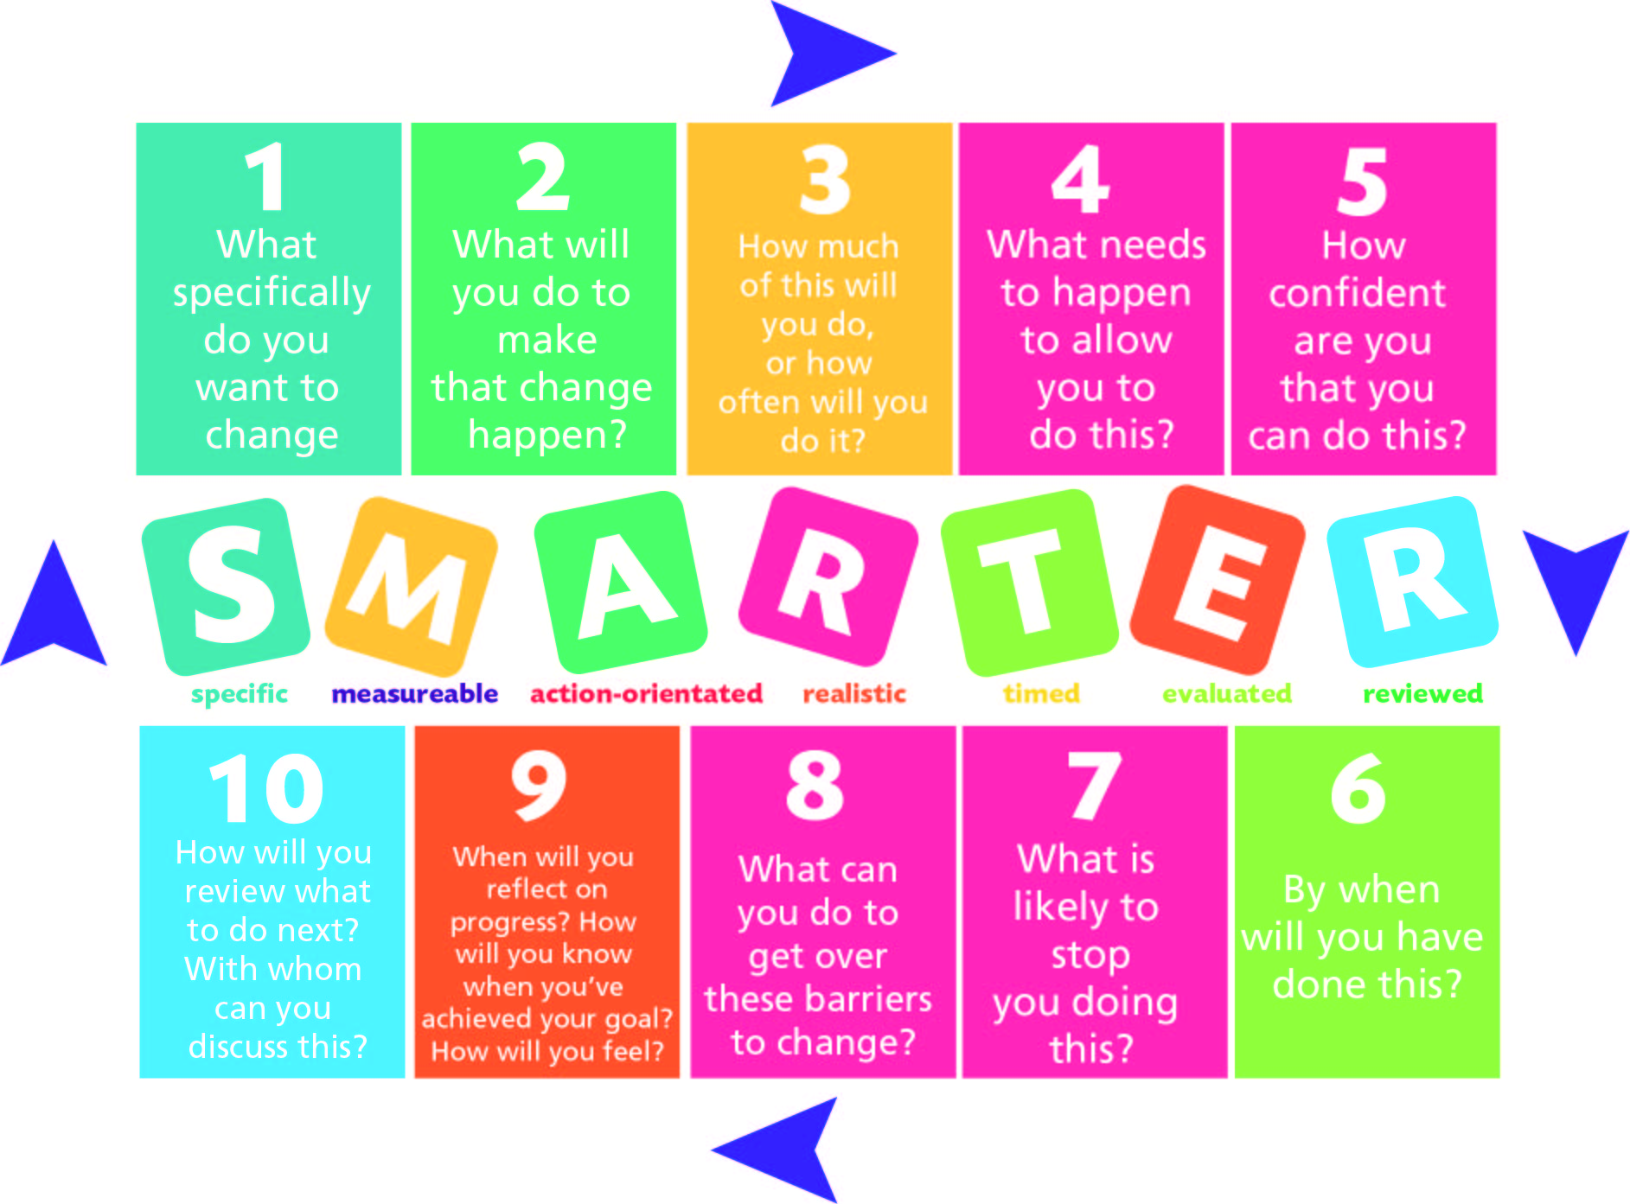
SMARTER Goals
Notes:
MECC focusses on brief interventions, but sometimes we may have longer conversations with individuals or see them regularly therefore providing the possibility for follow-up. In these cases, and if you feel able, it can be useful to think about setting goals. SMARTER is a useful acronym to ensure goals are appropriately set but also reviewed! Specific – Measurable – Action Orentiated – Realistic – Timed – Evaluated – Reviewed
This is not something that can be done in a very brief intervention so it is more appropriate for longer conversations or when you get the opportunity to follow up with an individual. During a brief intervention though, it might be possible to use a certain element of the SMARTER goal-setting acronym, for example you might agree on a specific goal for an individual, without making it measurable or timed.

Slide 15
Knowledge Check
How can you phrase questions to make them open-discovery questions?
Where can you signpost individuals to so they can access further support in their local area?
What does the SMARTER acronym stand for?
According to the MECC principles, are the following statements true or false?
  You are responsible for the choices people make
  Being given information alone does not make people change
  People do not come to us with solutions
  It is not possible to persuade people to change their habits

Slide 16
Knowledge Check: Answers
How can you phrase questions to make them open-discovery questions? ‘What’ and ‘How’ Questions
Where can you signpost individuals to so they can access further support in their local area? MECC Link
What does the SMARTER acronym stand for? Specific, measurable, action-orientated, realistic, timed, evaluated, reviewed
According to the MECC principles, are the following statements true or false?
  You are responsible for the choices people make FALSE
  Being given information alone does not make people change TRUE
  People do not come to us with solutions FALSE
  It is not possible to persuade people to change their habits TRUE
Notes:
What and how questions
MECC Link
Specific, measureable, action-orientated, realistic, timed, evaluated, reviewed
Correct statements:
You are not responsible for the choices people make
Being given information alone does not make people change
People do come to us with solutions
It is not possible to persuade people to change their habits

Slide 17
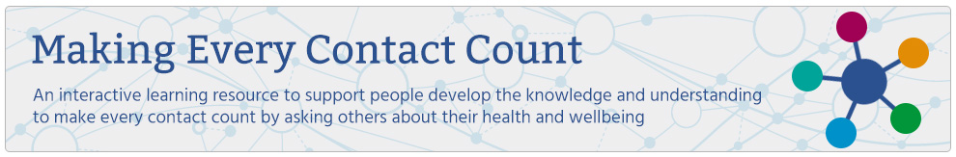
Accessing Formal MECC Training
E-learning for health module
Half day interactive course
Notes:
If you want to learn more about MECC then check out these resources to enhance your training in this area.
The e-learning for health module can be done in your own time at home. It will cover similar content to this module but will have more opportunity for interaction.
Making Every Contact Count - elearning for healthcare (e-lfh.org.uk)
Once you’ve completed the e-learning materials you may also be interested in signing up for formal training. This is delivered either in-person or on Teams and lasts a half day. This is an interactive course with an opportunity to practice having MECC conversations and getting feedback. Visit the link to look at available options for this course.
MECC (Making Every Contact Count) BSW Tickets, Tue 17 May 2022 at 13:30 | Eventbrite

